Slide 1
Notes:
Customers will never love a company until the employees love it first.

Slide 2

Notes:
Change the idea of corporate culture and flip it upside down.

Slide 4

Notes:
Remove job titles. Remove policies.

Slide 5


Slide 6


Slide 7
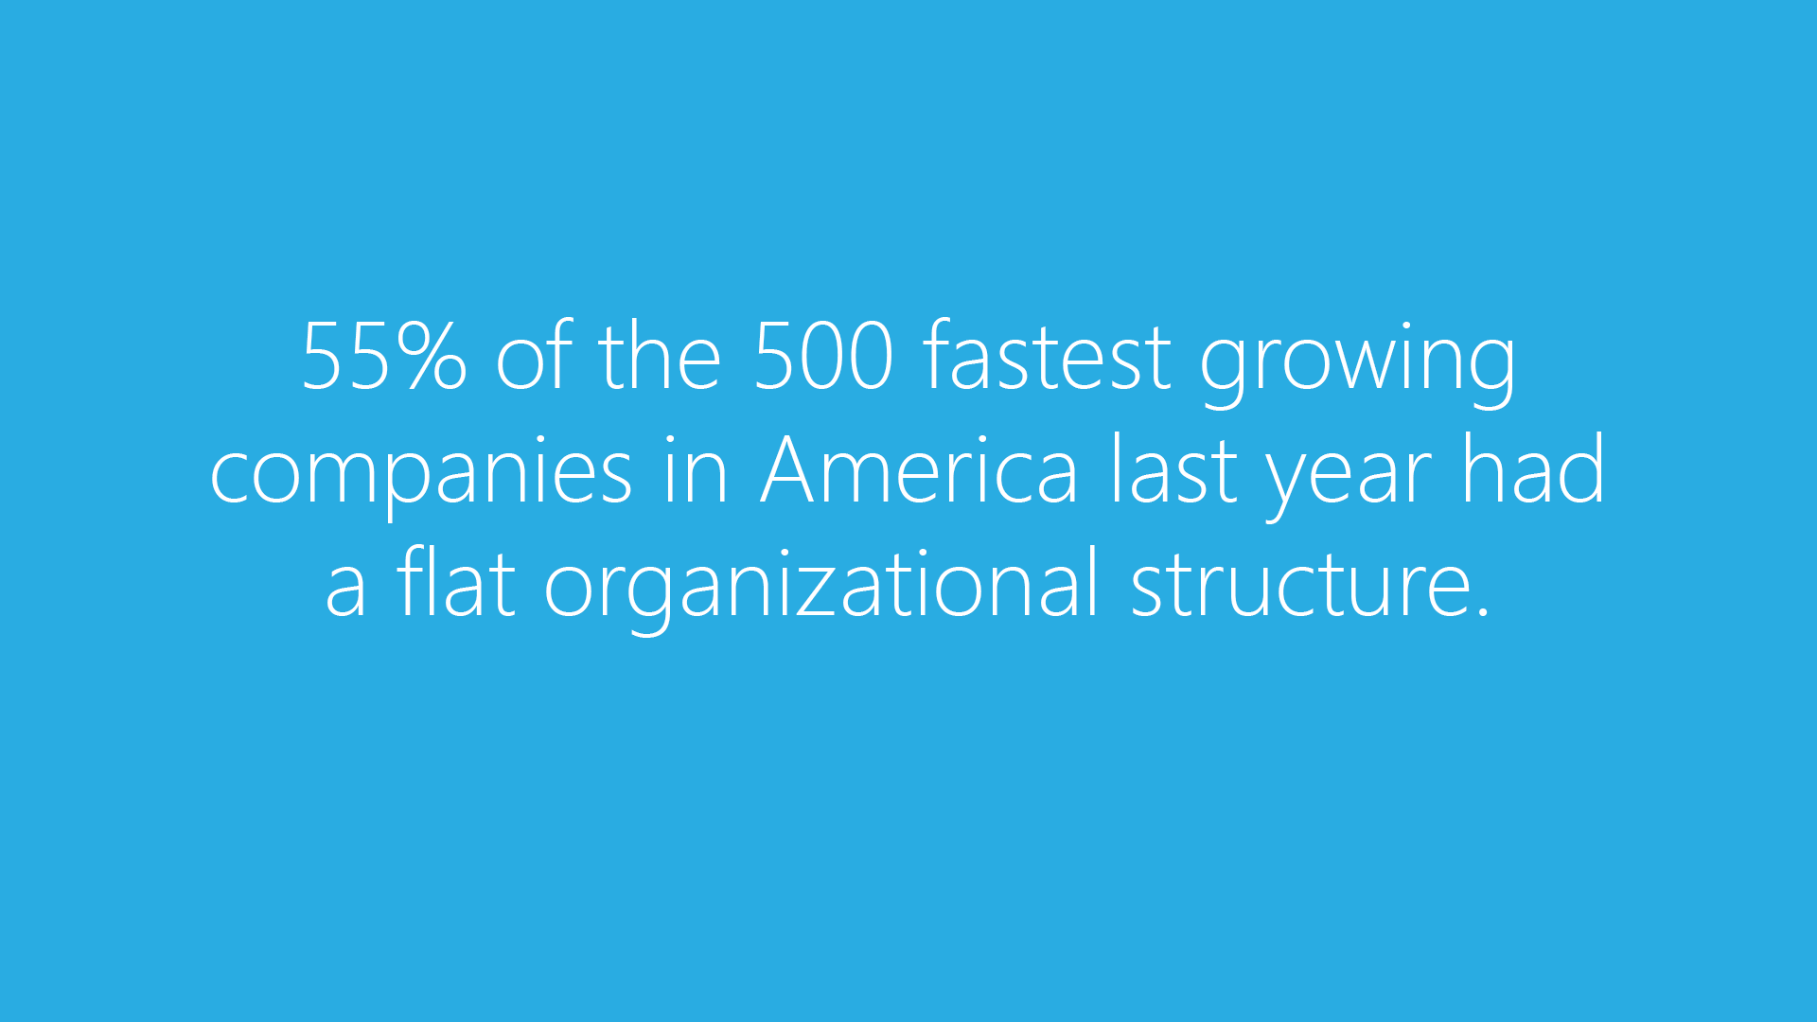

Slide 8


Slide 9


Slide 10
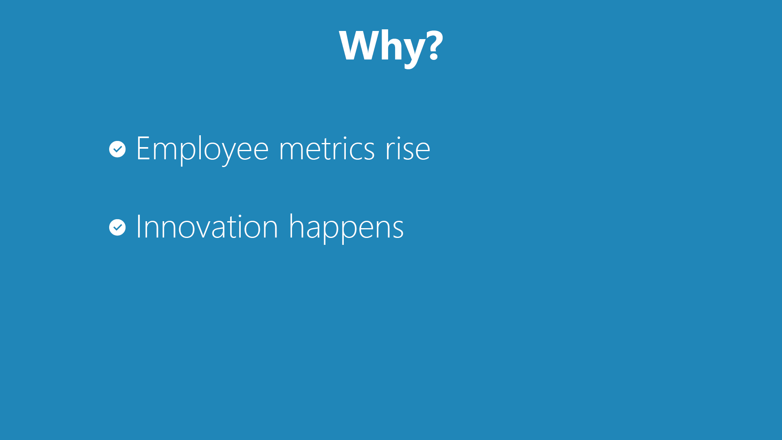

Slide 11
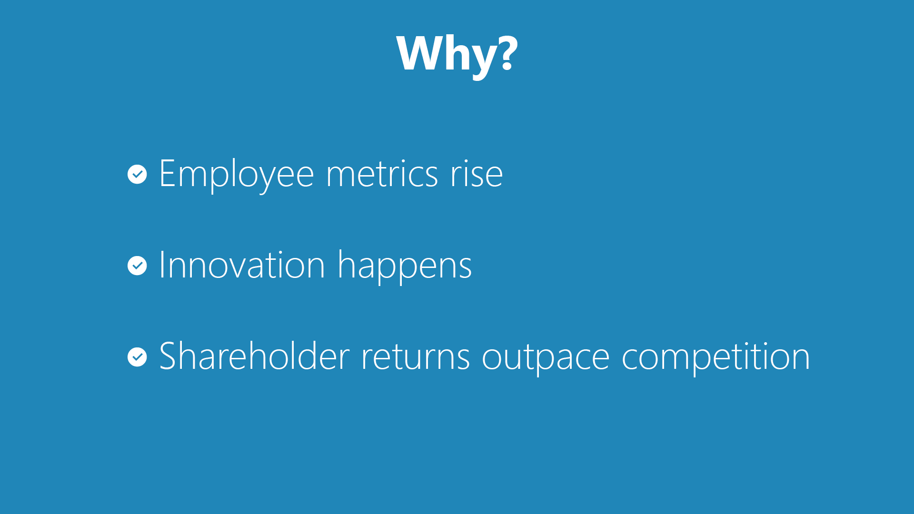

Slide 12


Slide 13


Slide 14
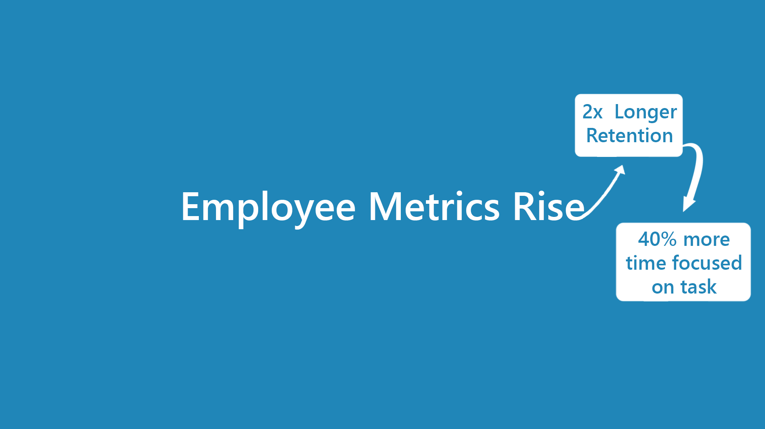

Slide 15


Slide 16
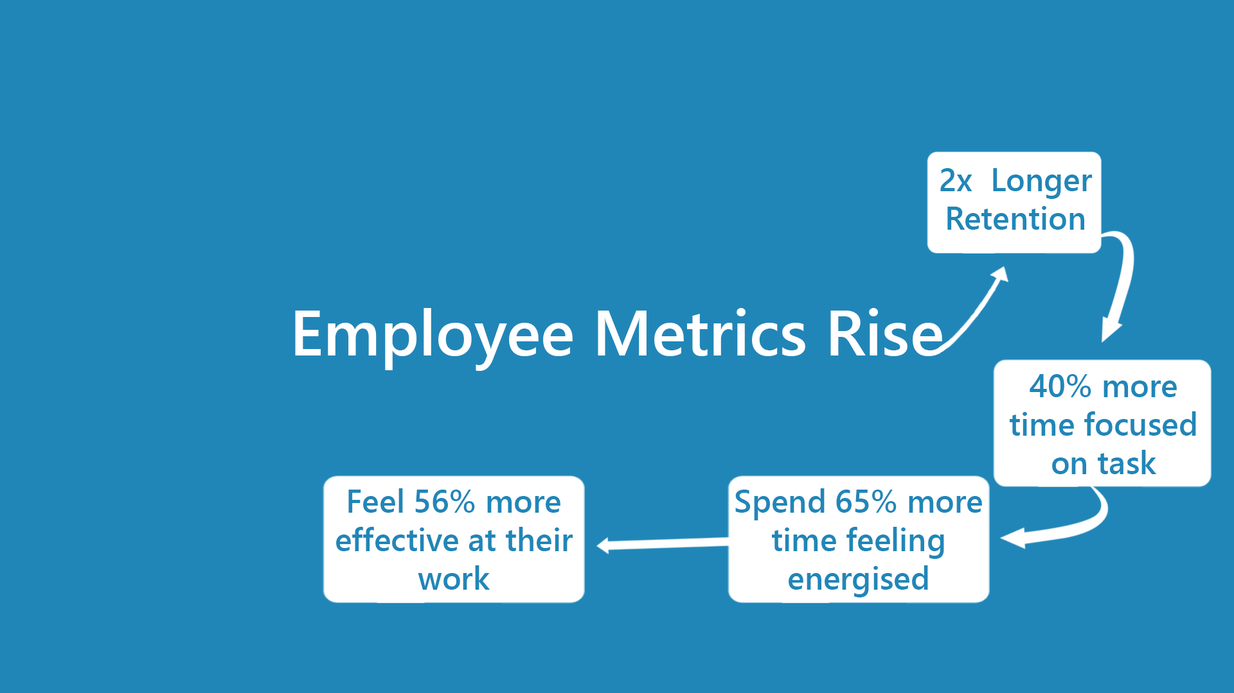

Slide 17
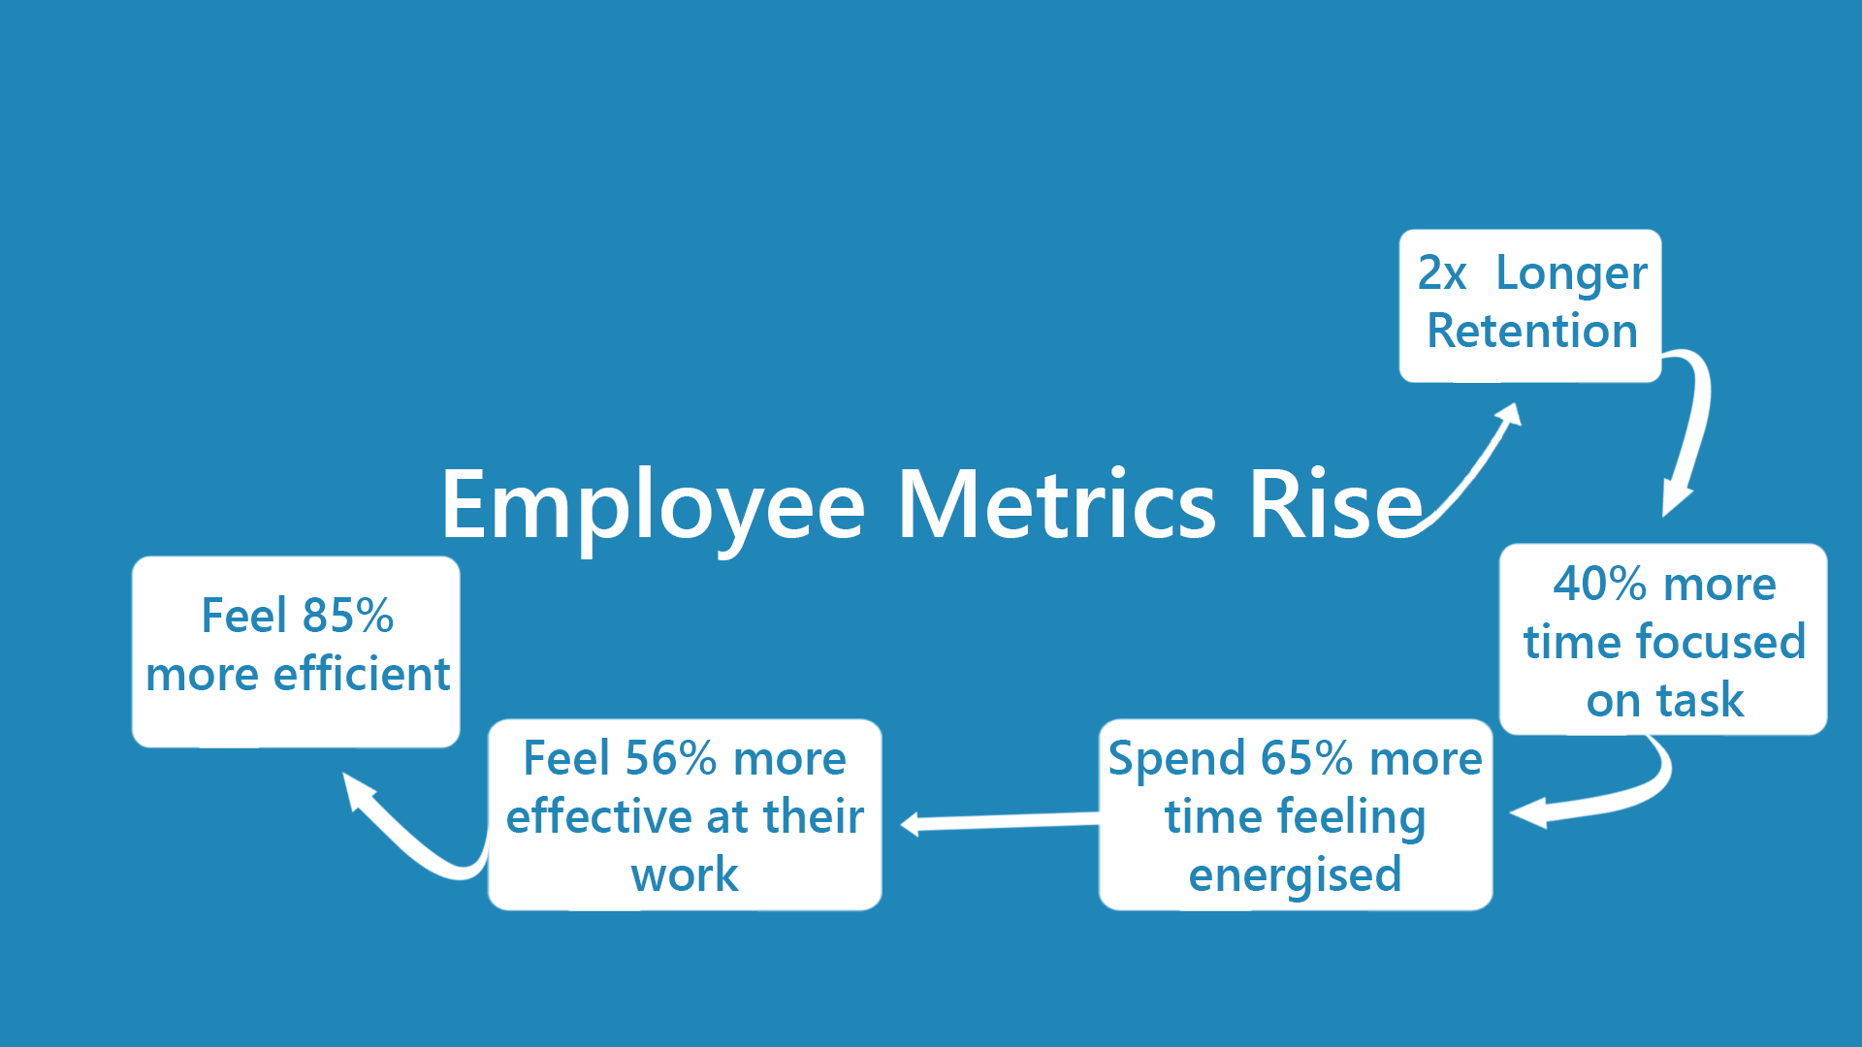

Slide 18
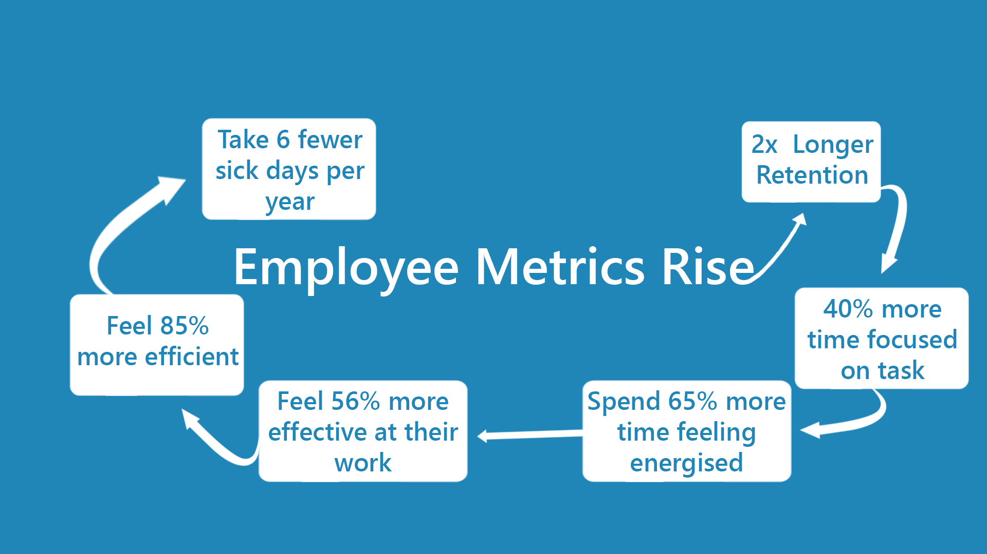

Slide 19


Slide 21


Slide 22
Notes:
Remove job titles. Remove policies.

